Slide 1
7
SERIES OF FUNCTIONS
Copyright © Cengage Learning. All rights reserved.

Slide 2
7.2
Representing Functions as Power Series
Copyright © Cengage Learning. All rights reserved.

Slide 3
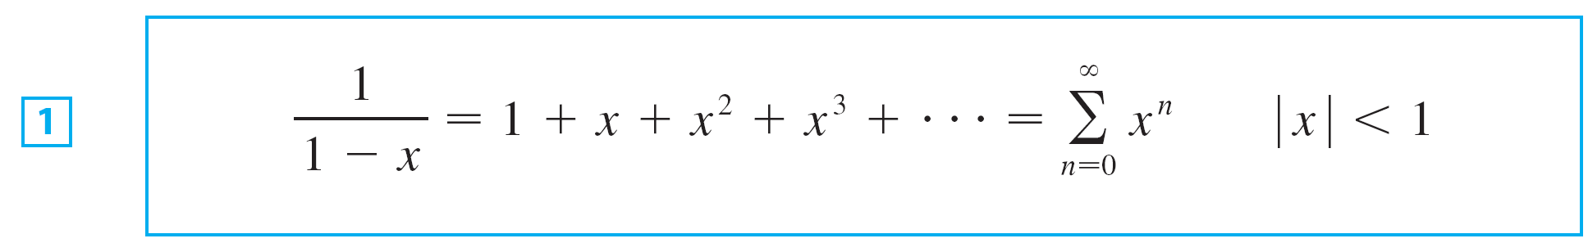
Representing Functions As Power Series
In this section we learn how to represent certain types of functions as sums of power series by manipulating geometric series or by differentiating or integrating such a series.
This strategy is useful for integrating functions that don’t have elementary antiderivatives, for solving differential equations, and for approximating functions by polynomials.
We start with an equation:

Slide 4

Representing Functions As Power Series
We have obtained that the series is geometric series with a = 1 and r = x. But here our point of view is different.
We now regard Equation 1 as expressing the function
as a sum of a power series.

Slide 5
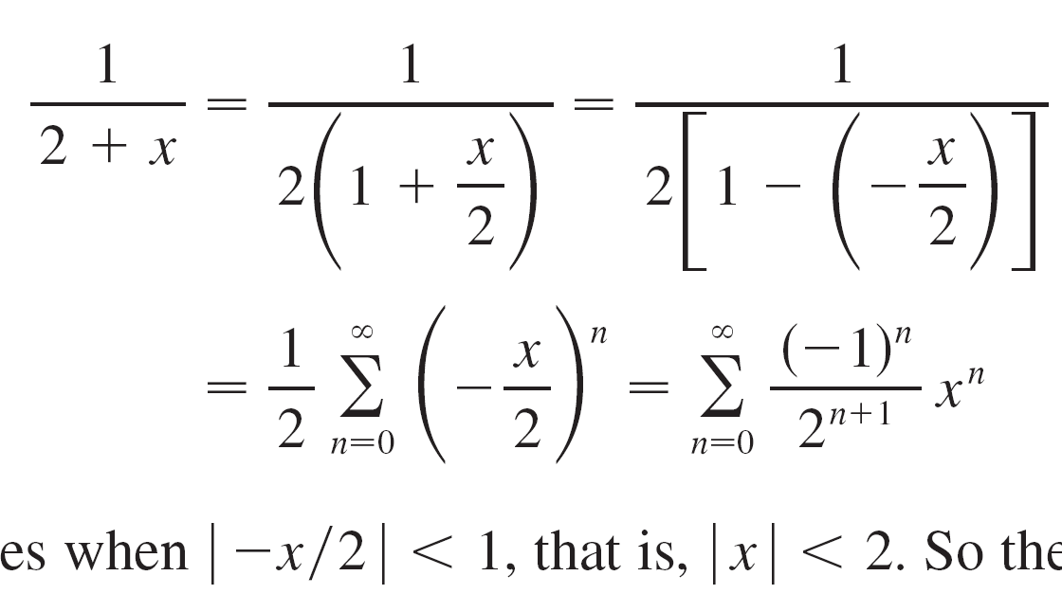
Example 2
Find a power series representation for 1/(x + 2).
Solution:
In order to put this function in the form of the left side of Equation 1 we first factor a 2 from the denominator:

Slide 6
Example 2 – Solution
cont’d
This series converges when , that is,
So the interval of convergence is (–2, 2).

Slide 7
Differentiation and Integration
of Power Series

Slide 8

Differentiation and Integration of Power Series
The sum of a power series is a function whose domain is the interval of convergence of the series.
We would like to be able to differentiate and integrate such functions, and the next theorem says that we can do so by differentiating or integrating each individual term in the series, just as we would for a polynomial.
This is called term-by-term differentiation and integration.

Slide 9
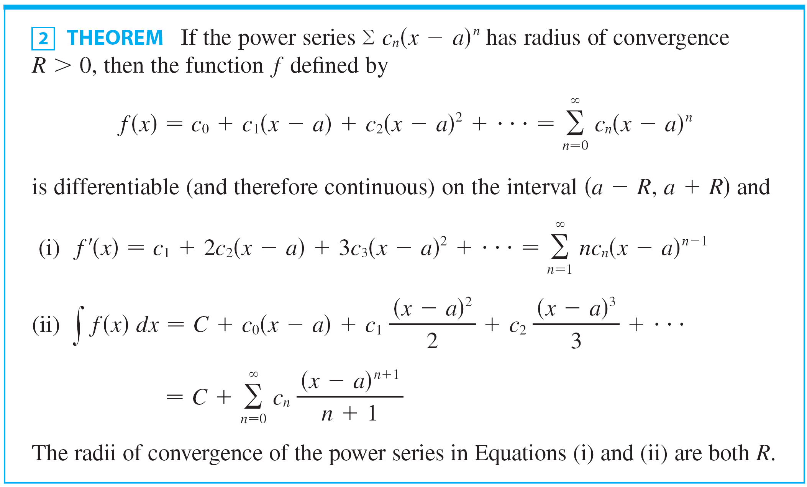
Differentiation and Integration of Power Series

Slide 10
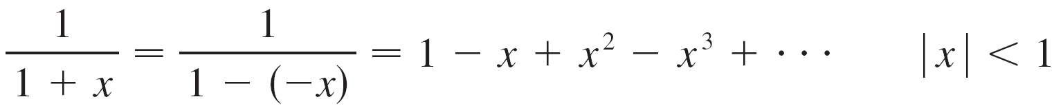
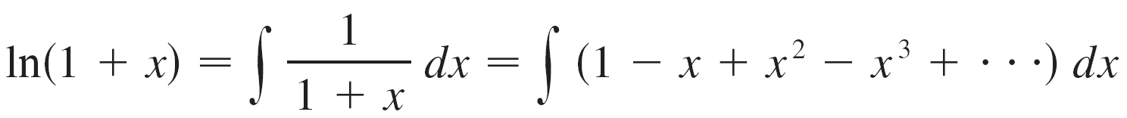
Example 6
Find a power series representation for In(1 + x) and its radius of convergence.
Solution:
We notice that the derivative of this function is 1/(1 + x). From Equation 1 we have
Integrating both sides of this equation, we get

Slide 11
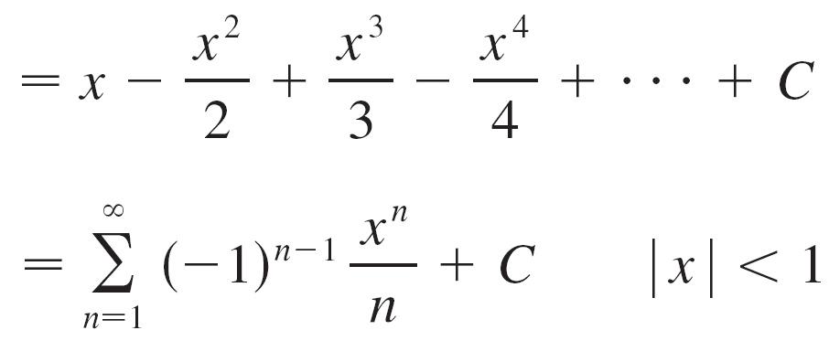
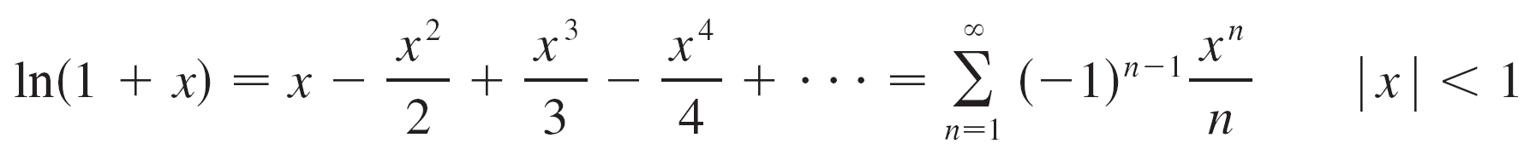
Example 6 – Solution
cont’d
To determine the value of C we put x = 0 in this equation and obtain In(1 + 0) = C.
Thus C = 0 and

Slide 12
Example 6 – Solution
cont’d
The radius of convergence is the same as for the original series: R = 1.

Slide 13

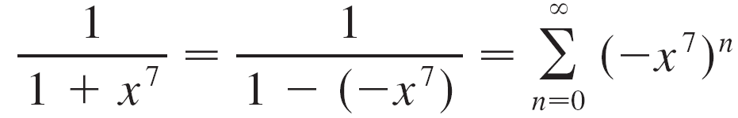
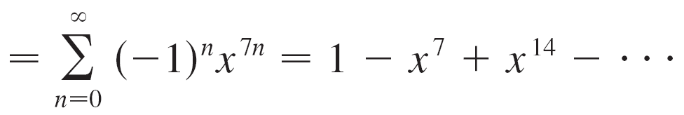
Example 8
Evaluate as a power series.
Solution:
The first step is to express the integrand, 1/(1 + x⁷), as the sum of a power series.
Replacing x by –x⁷ in Equation 1, we have

Slide 14
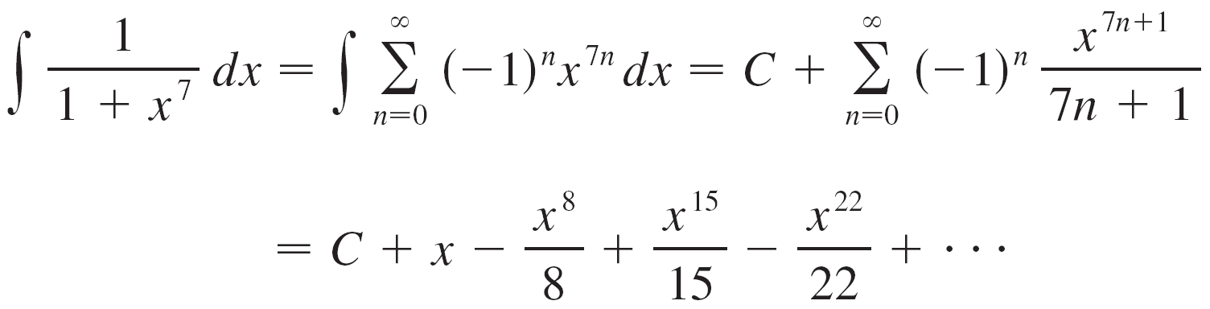

Example 8 – Solution
cont’d
Now we integrate term by term:
This series converges for , that is, for .

